Slide 1
Chapter 13 Object Serialization
FALL 2021

Slide 2
Serialization and Deserialization
Object serialization: the process of converting an object into a stream of bytes that includes the object’s data as well as information about the object’s type and the types of data stored in the object.
Object deserialization: the process of converting a stream of bytes into a copy of the original object.

Slide 3
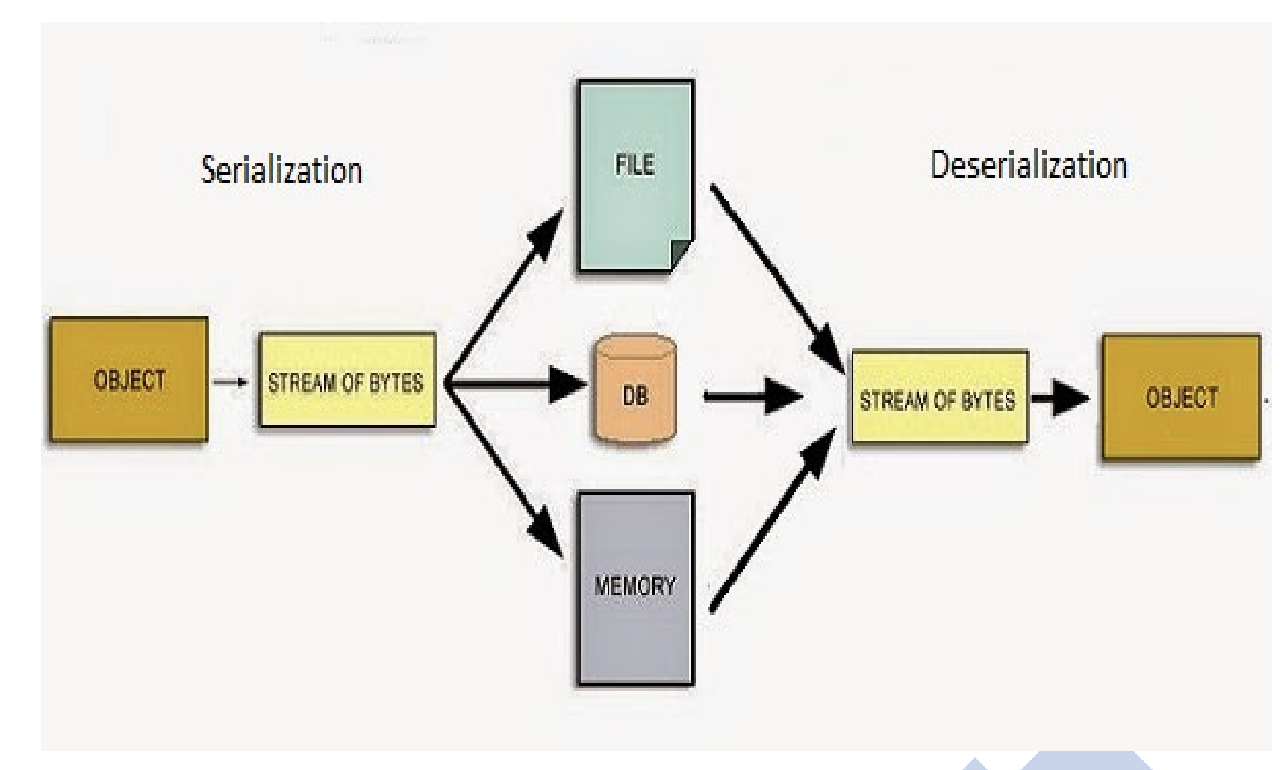

Slide 4
Java’s Serialization Algorithm
In general, the serialization algorithm does the following:
It writes out the metadata of the class associated with an instance
It recursively writes out the description of the superclass until it finds java.lang.object
It then starts writing the actual data associated with the instance

Slide 5
Serializable objects
An object on any class that implements the Serializable interface can be saved and restored from a stream of bytes
Java.io.Serializable is an example of marker interface
A marker interface is an interface that is entirely empty
A class can implement this interface simply by naming it in its implements clause without to implement any methods

Slide 6
Subclasses of Serializable classes are also serializable
Associated objects must be implementing Serializable interface
The implication is that any object we serialize must contain only references to other Serializable objects

Slide 7
NotSerializable exception
The object stream methods will throw NotSerializableException (RuntimeException) when attempting to write or read an instance that is not serializable

Slide 8
Transient
The transient modifier can be applied to any instance variable to indicate that its contents are not useful outside of the current context and should never be saved or serialized.
When to use transient:
Avoid serializing object references to non serialized objects
When we do not want an object to be serialized.
//Making password transient for security
private transient String password;

Slide 9

IO streams
Special streamclasses from the package java.io, ObjectInputStream and ObjectOutputStream, are used to serialize primitive types and objects.
The ObjectOutputStream class contains writeObject() method for serializing an Object
The ObjectInputStream class contains readObject() method for deserializing an object

Slide 10
Deserialization - ClassNotFoundException
For a JVM to be able to deserialize an object, it must be able to find the bytecode for the class.
If the JVM cannot find a class during the deserialization of an object, it throws a ClassNotFoundException

Slide 11
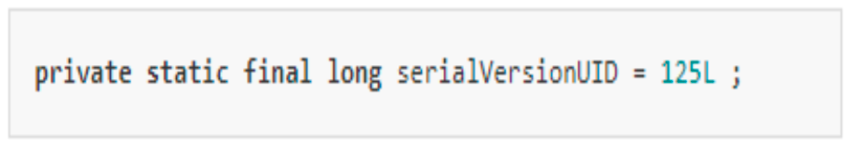
SerialVersionUID
Java uses serialVersionUID attribute to remember versions of a Serializable class:
The serialVersionUID is used to verify that a loaded class and the serialized object are compatible
If serialVersionUID is not provided in a Serializable class, the JVM will generate one automatically
Any subsequent changes to the class may break the serialization compatibility

Slide 12
InvalidClassException
If during deserialization, the serialVersionUID in the stream is different from that in the version of the class loaded in the JVM, an InvalidClassException (RuntimeException) is thrown.
This ensures that the class used while deserializing in the same as that used while serializing
It is good practice to provide your own serialVersionUID

Slide 13
References
Java How to Program, chapter 15: Files, Input Output streams, NIO and XML serialization.
https://docs.oracle.com/javase/tutorial/essential/io/index.html

